Slide 1

E-Banking system

Slide 2
aim:
To perform testing and identifying positive and negative test case scenarios for login module and fund transfer module in e-banking system.

Slide 3
E-BANKING APPLICATIONS: (METHODS)
1.LOGIN MODULE
2.SEARCHING MODULE
3. PURCHASE MODULE
4. PAYMENT MODULE
5.DELIVERY AND BILLING MODULE
6.ADDING CUSTOMERS TO BANK.

Slide 4
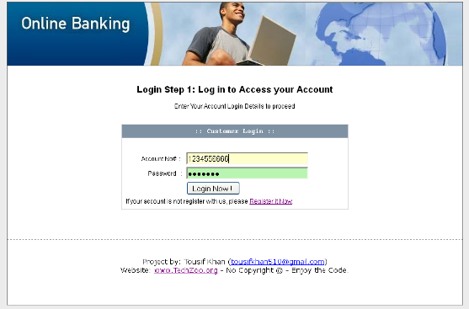
The login module:

Slide 5
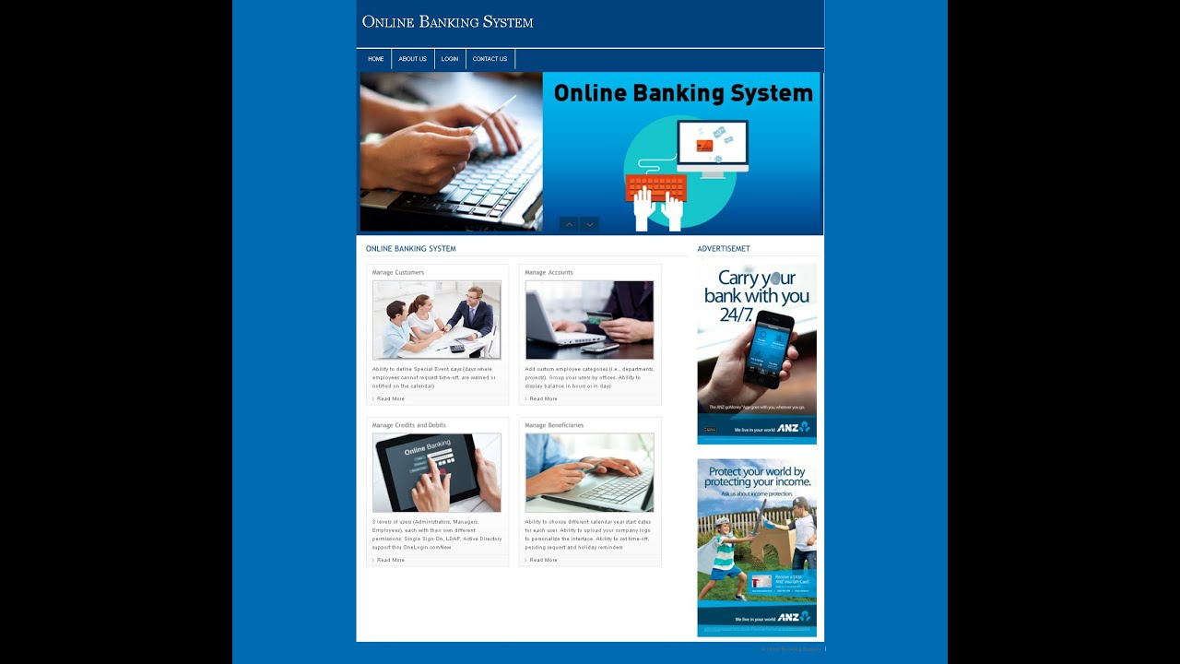
Searching module:

Slide 6
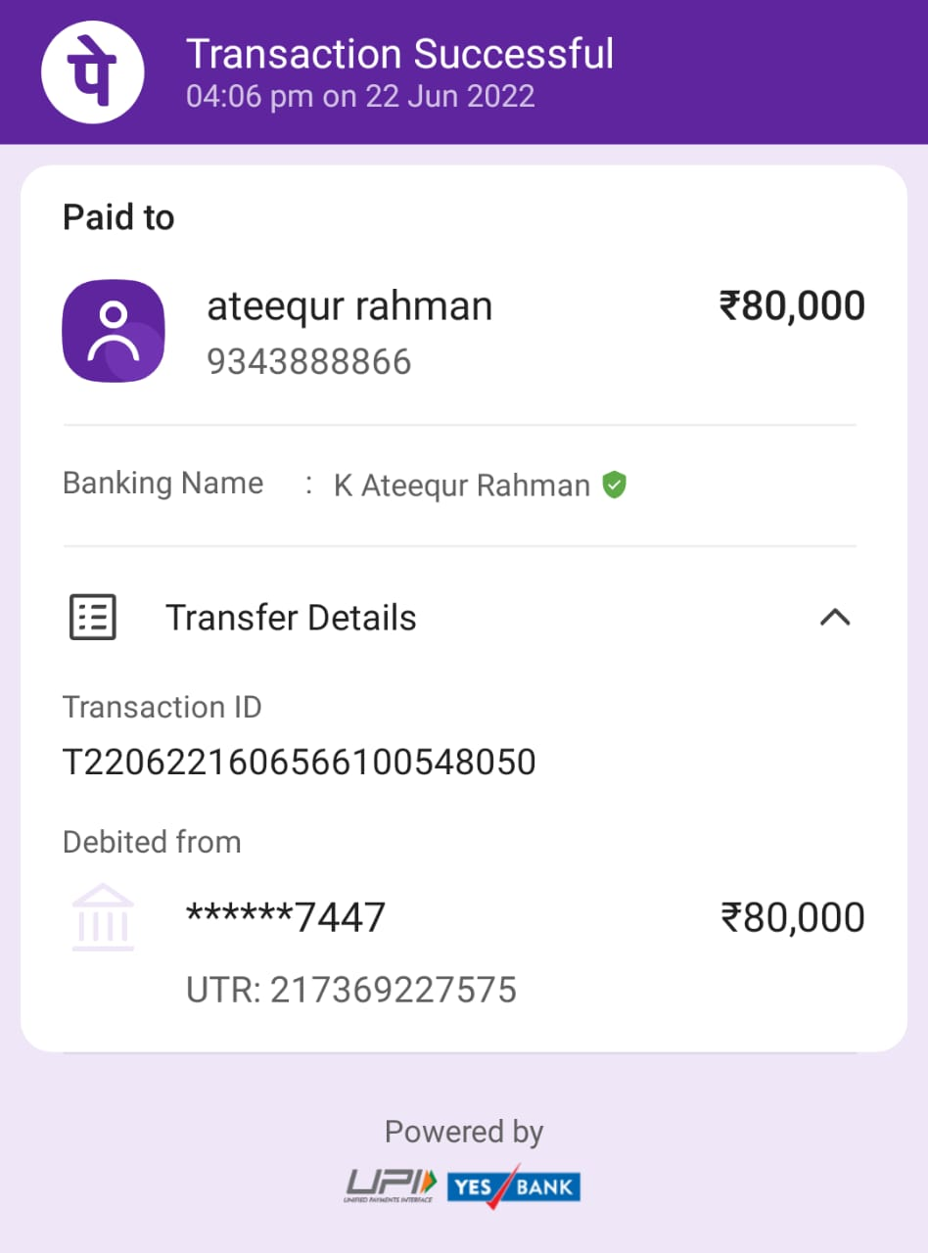
Payment module:

Slide 7
Test case scenario for login module(phonepe):
Sr. No. | Functional Test Cases | Type- Negative/ Positive Test Case
1 | Verify if a user will be able to login with a valid username and valid password. | Positive
2 | Verify if a user cannot login with a valid username and an invalid password. | Negative
3 | Verify the login page for both, when the field is blank and Submit button is clicked. | Negative
Functional Test Cases:

Slide 8
4 | Verify the ‘Forgot Password’ functionality. | Positive
5 | Verify the messages for invalid login. | Positive
6 | Verify the ‘Remember Me’ functionality. | Positive
7 | Verify if the data in password field is either visible as asterisk or bullet signs. | Positive
8 | Verify if a user is able to login with a new password only after he/she has changed the password. | Positive
9 | Verify if the login page allows to log in simultaneously with different credentials in a different browser. | Positive
10 | Verify if the ‘Enter’ key of the keyboard is working correctly on the login page. | Positive

Slide 9
Test case scenario for fund transfer:
Go to the bank website login page.
Input username and password.
Go to the money transfer page.
Add the beneficiary to whom you want to transfer money.
Check the details of the bank account and person. Verify if they are correct.
Select the specific money transfer method from NEFT/RTGS or SWIFT transfer options.
Select the beneficiary name, and funds, and then submit the details.
Verify the amount and other details on the verification page.
Click submit for the final action of fund transfer.

Slide 10
Conclusion:
While writing test cases for login or sign-up page write the test cases for all the fields. There should be a combination of both positive and negative test cases. Try to cover the performance, security, and functional scenarios.

